Slide 1
Structured Forests for Fast Edge Detection
Piotr Dollár and Larry Zitnick

Slide 2
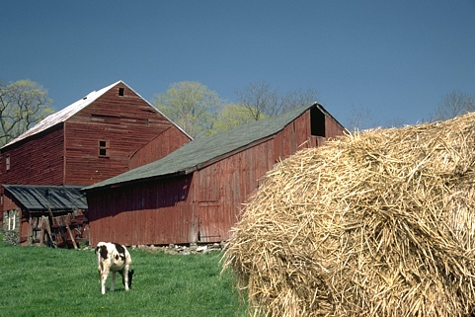
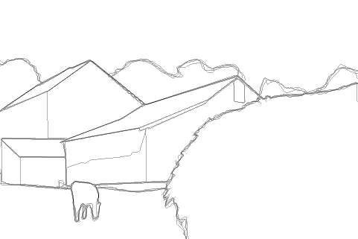
what defines an edge?
Brightness
Color
Texture
Parallelism
Continuity
Symmetry
…
Let the data speak.

Slide 3
1. Accuracy
2. Speed

Slide 4
I. data driven edge detection

Slide 5
edge detection as classification
{ 0, 1 }
Hard!
positives
Supervised Learning of Edges and Object Boundaries
CVPR 2006, Piotr Dollár, Zhuowen Tu, Serge Belongie

Slide 6
edge have structure

Slide 7
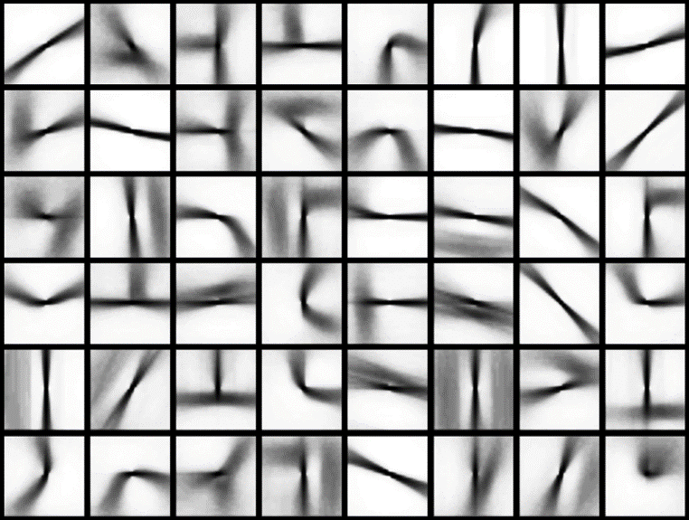
sketch tokens
Sketch Tokens, CVPR 2013. Joseph Lim, C. Zitnick, and P. Dollár

Slide 8
random forests

Slide 9
upgrading the output space
dimensionality
{ 0, 1 }
2
{ … }
151
2²⁵⁶

Slide 10
II. structured edge learning

Slide 11
structured forests
Structured Class-Labels in Random Forests for Semantic Image Labelling, ICCV 2011,
P. Kontschieder, S. Rota Bulò, H. Bischof, M. Pelillo

Slide 12
tree training

Slide 13
node training
low entropy split ☺
high entropy split ☹

Slide 14
how to train?
?
?
good split ☺
bad split ☹

Slide 15
minimize entropy
cluster
?
?

Slide 16
III. structured edge detection

Slide 17
structured forests

Slide 18
sliding window detector

Slide 19
sliding window detector
pixel output ☹
structured output ☺
Notes:
Comparison to storing only single pixel prediction
Noisy, no coherent structure
Would need far more trees!
This is the secret to our speed / accuracy.

Slide 20
multiscale detection

Slide 21
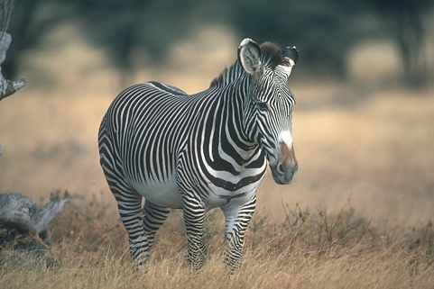
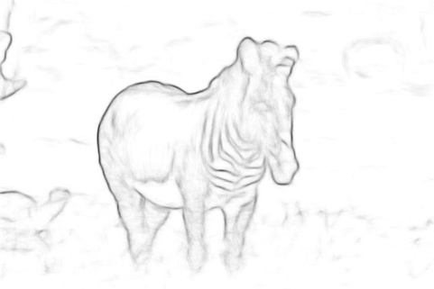
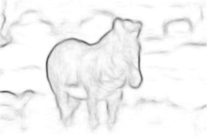
multiscale detection
+
+
½ x
1 x
2 x

Slide 22
IV. results

Slide 23
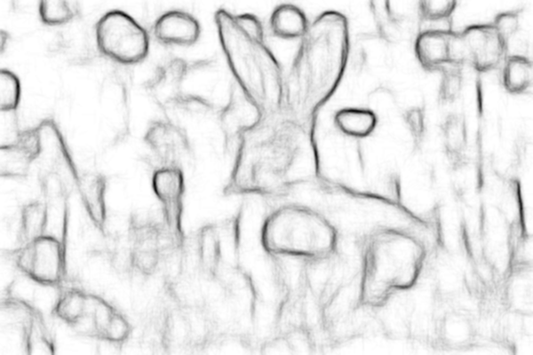
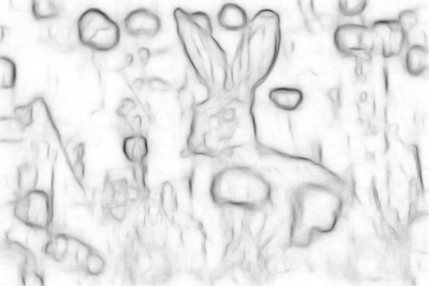
SS T=1
ODS = 0.72
60Hz
SS T=4
ODS = 0.73
30Hz
MS T=4
ODS = 0.74
6Hz
gPb ODS=.73 FPS ≈ 1/240 Hz
gPb ODS=.73
SS=single-scale MS=multi-scale T=# trees

Slide 25
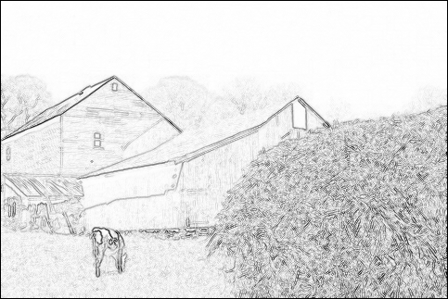
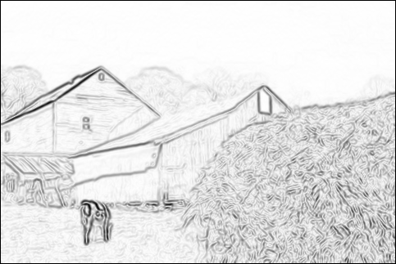
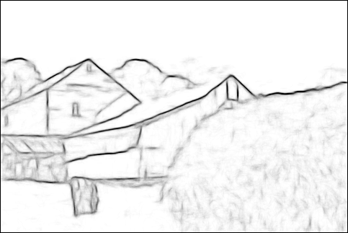

Slide 26
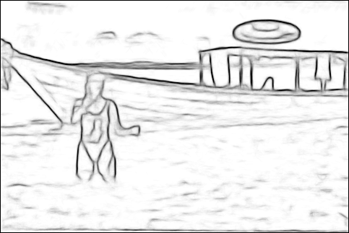

Slide 28
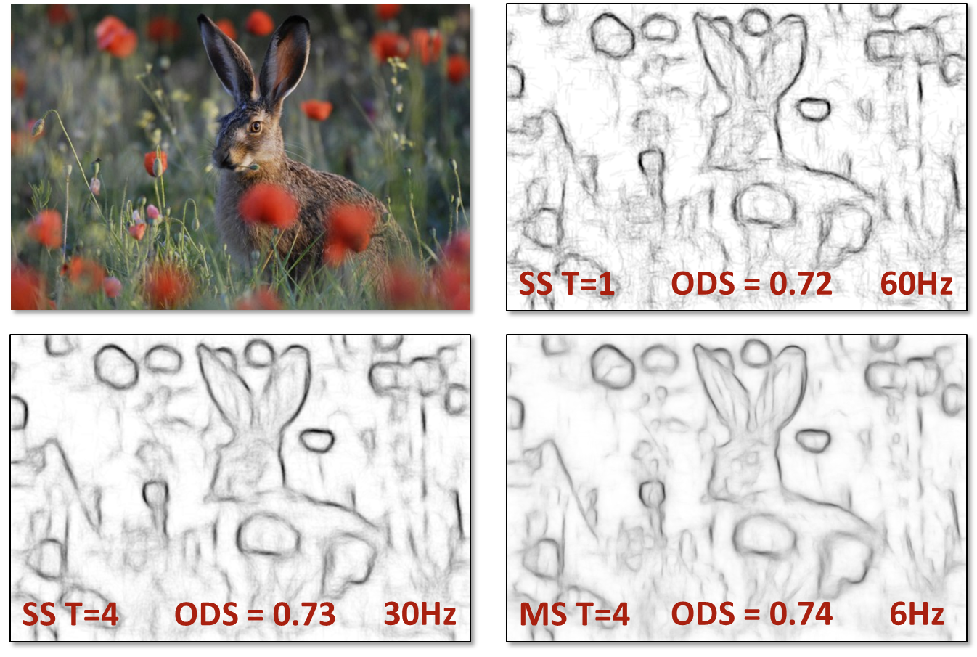
thanks!
source code available online

