Slide 1
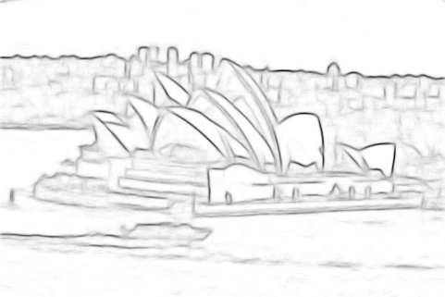
From Edges to Objects
Piotr Dollár and Larry Zitnick

Slide 2
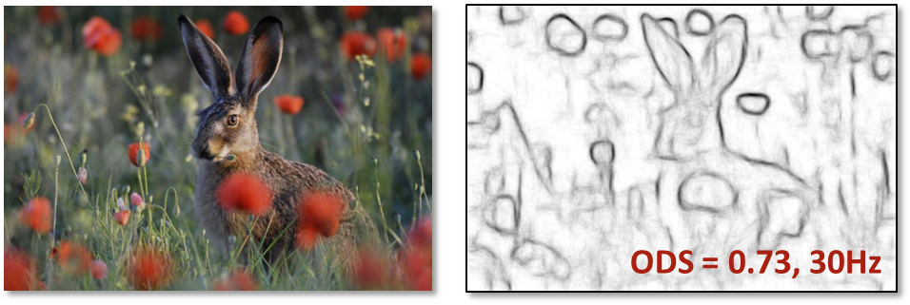
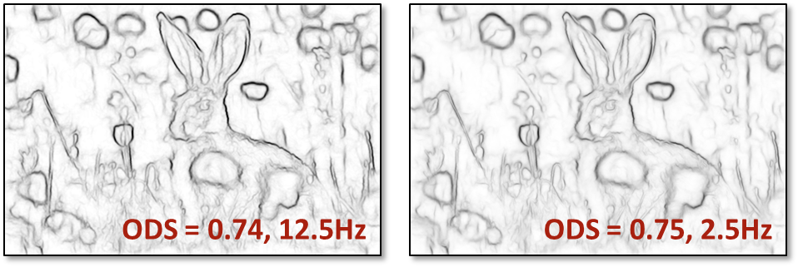
outline
structured edge prediction [Dollár & Zitnick, ICCV13, arXiv14]
from edges to objects [Zitnick & Dollár, ECCV14]

Slide 3
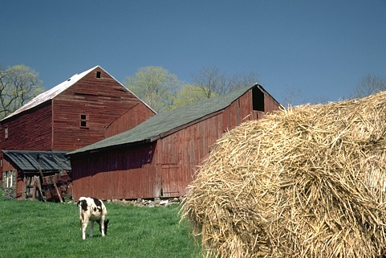
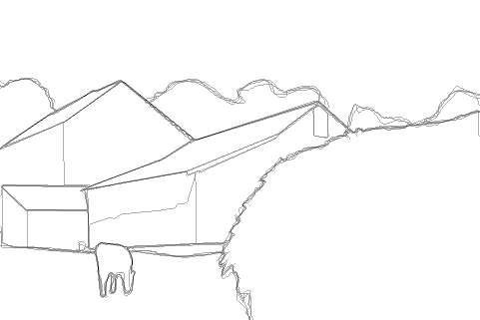
what defines an edge?
Brightness
Color
Texture
Parallelism
Continuity
Symmetry
…
Let the data speak.

Slide 4
upgrading the output space
bits
year
{ 0, 1 }
1
CVPR06
{ … }
8
CVPR13
256
ICCV13

Slide 5
random forests

Slide 6
structured forests

Slide 7
structured prediction

Slide 8
pixel prediction

Slide 9
sharpening

Slide 10
sharpened prediction

Slide 11
original image
pixel ☹
structured ☺
sharpened ☺☺

Slide 12
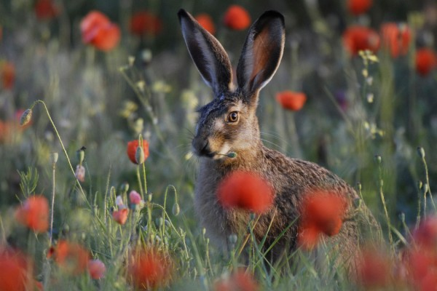
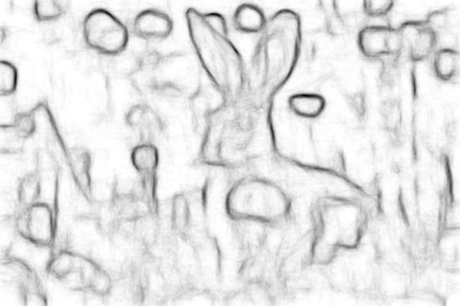
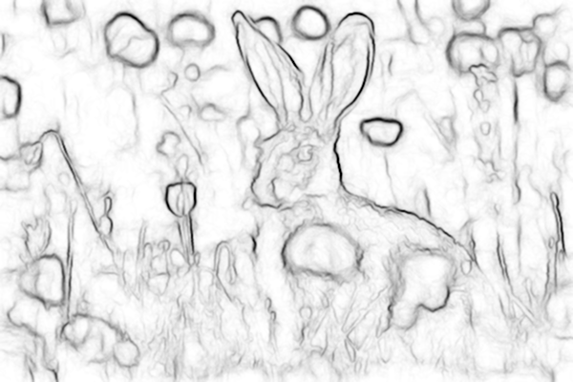
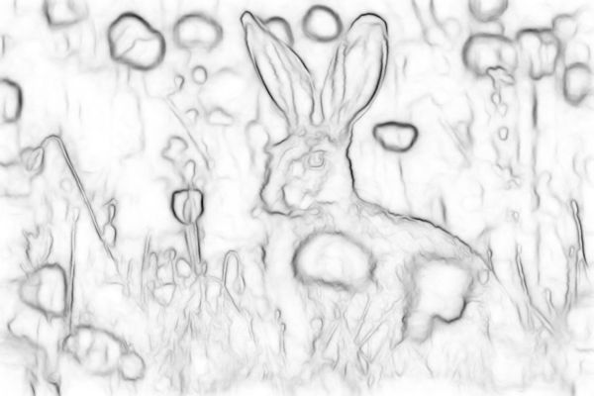
ODS = 0.73
30Hz
SH
ODS = 0.74
12.5Hz
SH+MS
ODS = 0.75
2.5Hz
gPb ODS=.73 FPS ≈ 1/240 Hz
gPb ODS=.73
SH = sharpen MS = multiscale

Slide 13
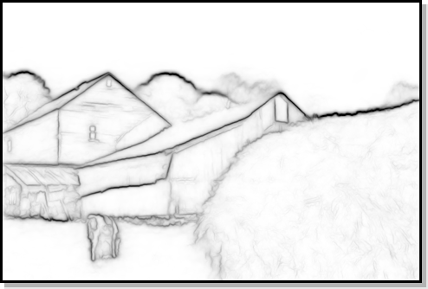
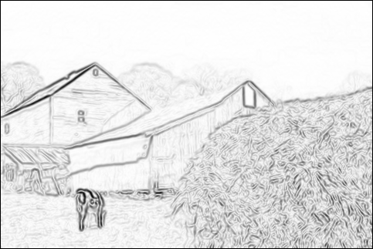

Slide 14
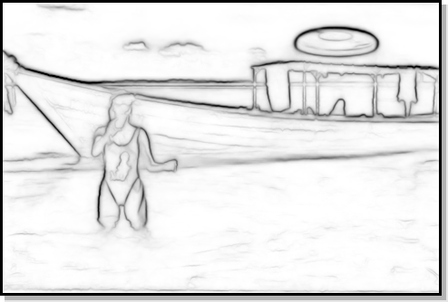
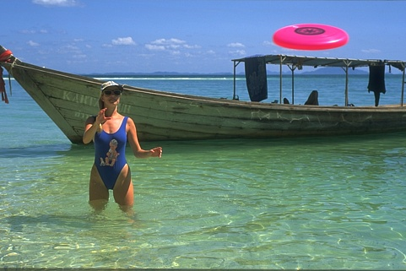
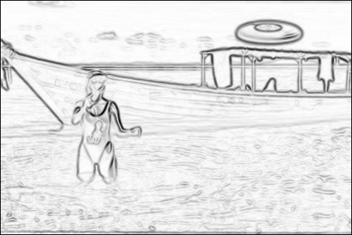

Slide 15
outline
structured edge prediction [Dollár & Zitnick, ICCV13, arXiv14]
from edges to objects [Zitnick & Dollár, ECCV14]

Slide 16
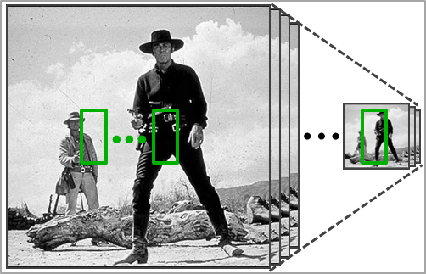
sliding window detection
restrictive!

Slide 17
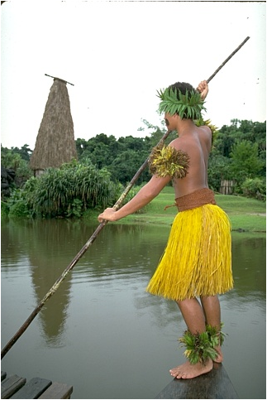
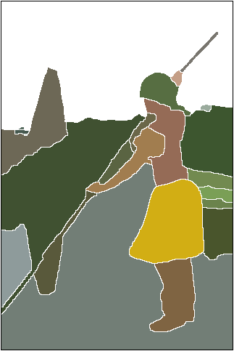
segmentation for detection
hard!

Slide 18
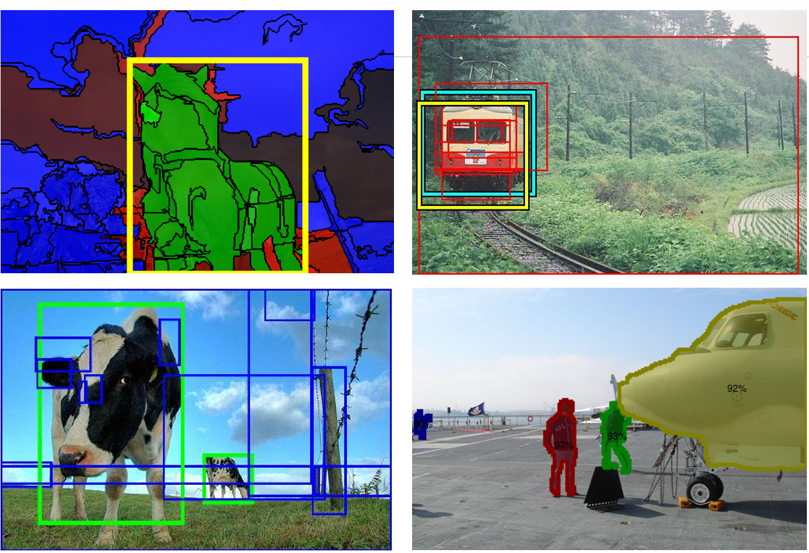
object proposals
Ojectness - 2010
Selective Search - 2011
CPMC - 2010
Random. Prim’s - 2013

Slide 19
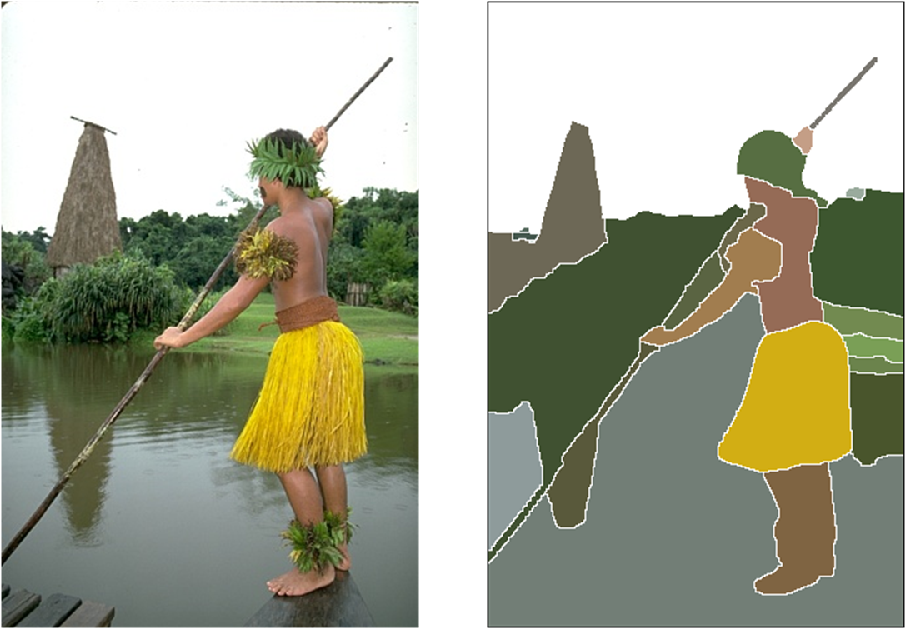
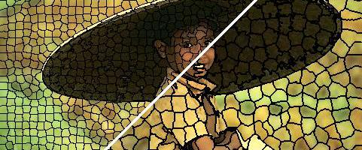
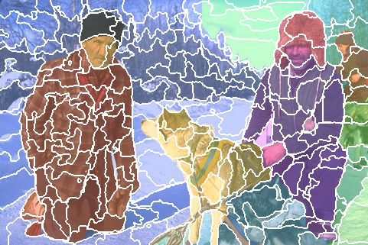
object proposals from ?
sliding windows? segments? superpixels?
SLIC - 2012
SEEDS - 2012

Slide 20
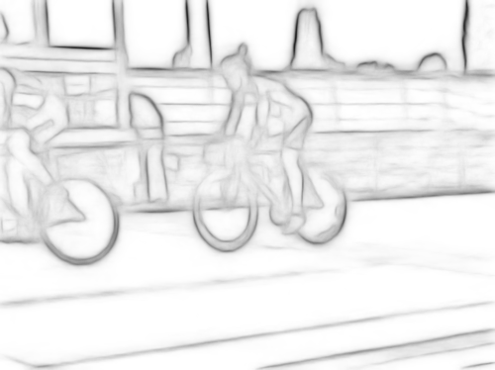

Slide 21
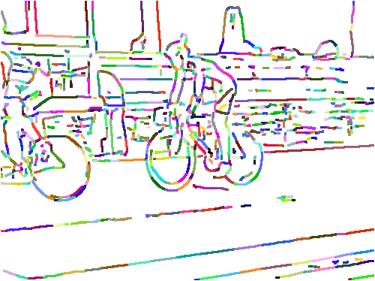

Slide 22
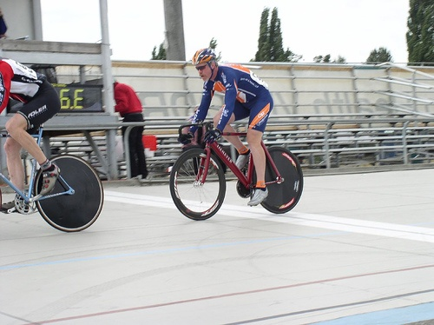

Slide 23
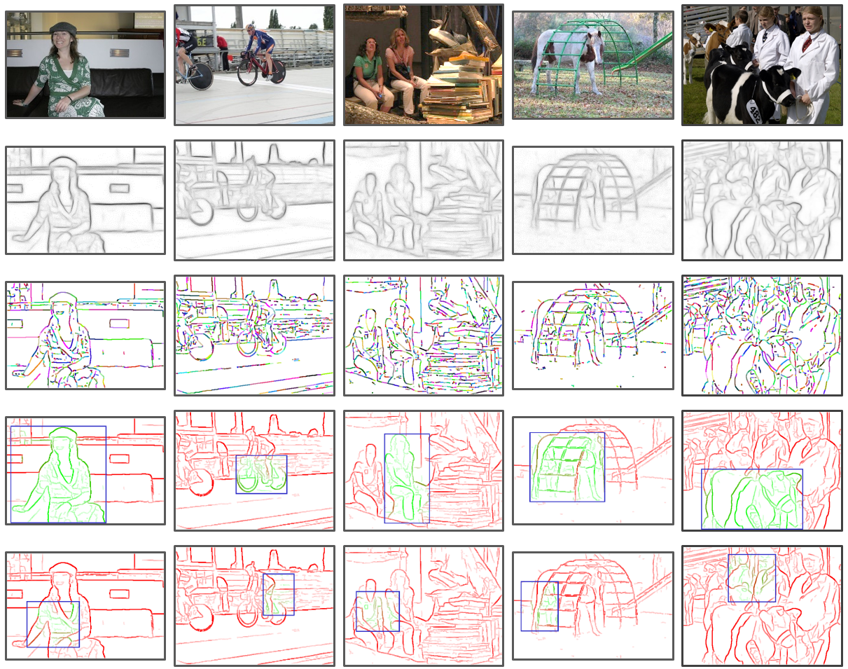

Slide 24
from edges to objects

Slide 25
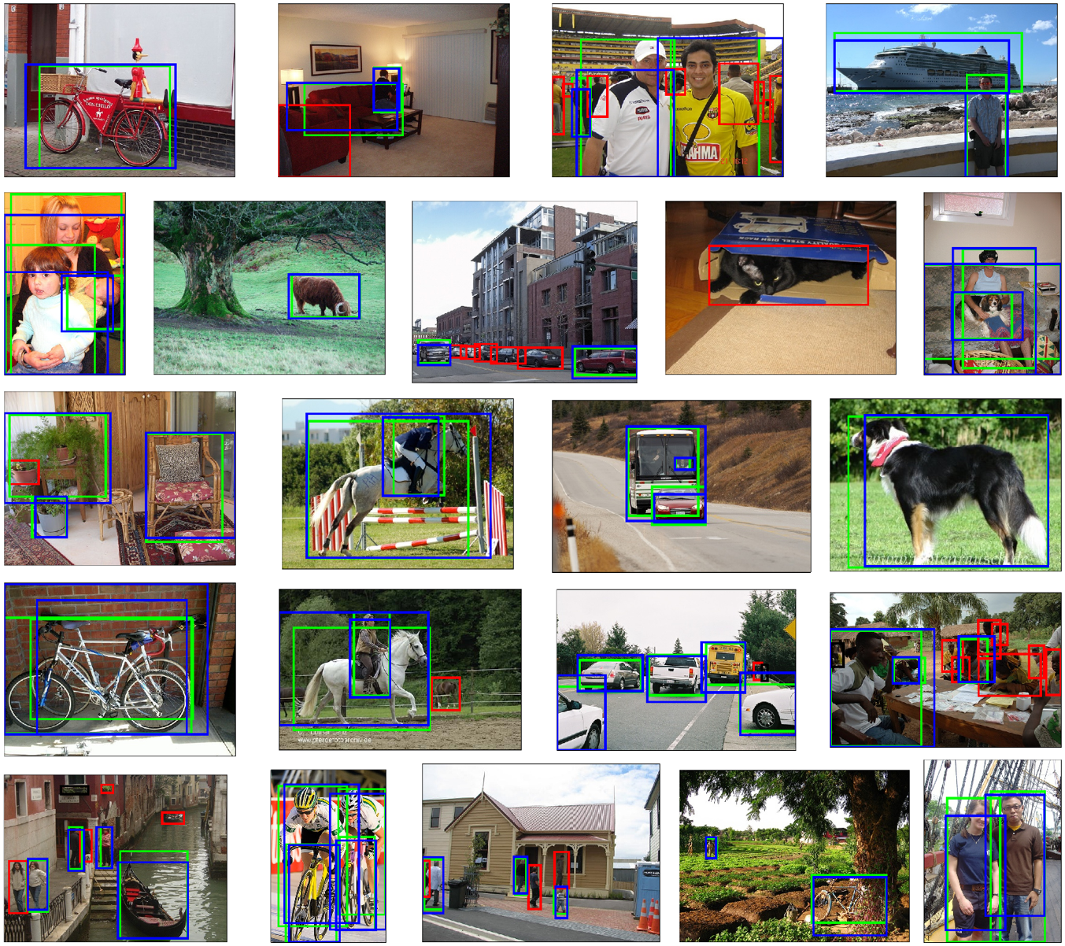

Slide 26
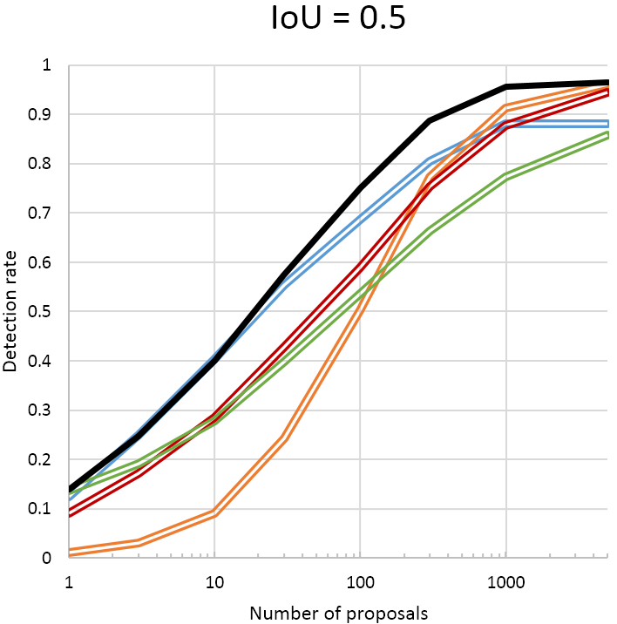

Slide 27
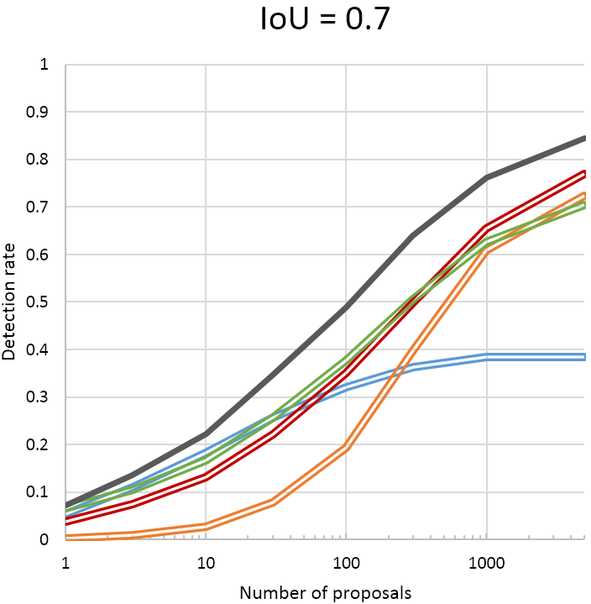
fast ☺

Slide 28
thanks!
source code available online

